Slide 1
COFFEE SALES DASHBOARD

Slide 2
OVERVIEW
This repository contains a detailed analysis of transactional sales data from a local coffee shop, covering individual sales records over time. The primary goal is to identify sales trends, analyze customer behavior patterns, and track the performance of top-selling products to inform future business and marketing strategies.
.

Slide 3
Key Metrics (KPMs)
The dataset contains 3547 transactions across a 13-month period, capturing product, revenue, and temporal data
Total Transactions- 3547
Total Sales Revenue- $112,245.58
Average Sales Amount- $31.65

Slide 4
Product Deep Dive: Top Sellers and Revenue Drivers
Top 3 Best-Selling Coffee Names (by Volume)-
Americano with Milk: 809 transactions
Latte: 757 transactions
Americano: 564 transactions
Top 3 Revenue Generating Coffee Names (by Sales Amount)-
Latte: $26,875.30
Americano with Milk: $24,751.12
Cappuccino: $17,439.14

Slide 5
When Do We Sell? Peak Times and Days
Sales by Time of Day (Total Revenue)-
Night: $38,186
Afternoon: $38,130
Morning: $35.929
Peak Sales Day (by Revenue)- Tuesday (Tue)
Top 3 Peak Sales Hours (by Revenue)-
10:00 (10 AM): $10,198
16:00 (4 PM): $9,031
11:00 (11 AM): $8,453

Slide 6
Key Outcomes and Strategic Recommendations
Product Focus: Latte and Americano with Milk are the business's backbone
Temporal Focus: Night is the highest revenue period; 10 AM is the highest-grossing hour
Payment: The business is entirely reliant on 100% card transactions.
Price Optimization: Review pricing for high-volume, lower-revenue items (like plain Americano) and low-volume, high-revenue items (like Cappuccino) to maximize profit margins.
Night-Time Offerings: Since Night is the top revenue period, promote premium evening items, desserts, or specialty night drinks to capitalize on this demand.
Operational Readiness: Ensure sufficient staff and inventory for the 10 AM, 11 AM, and 4 text peak hours.

Slide 7
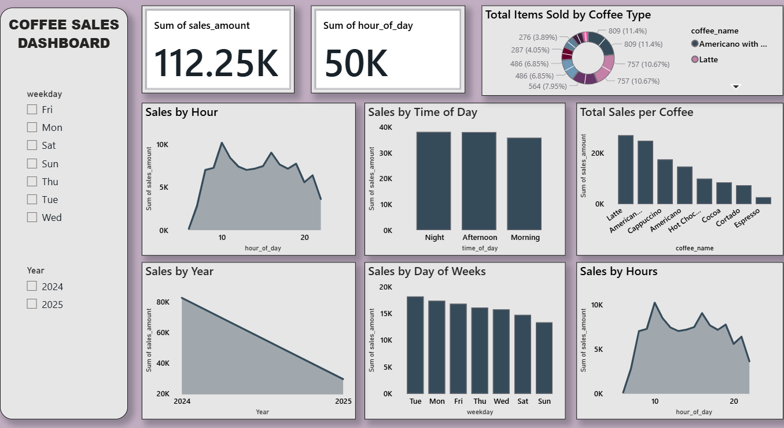
DASHBOARD

